Slide 1


Online Ordering System

Slide 2
Supervisor
Akhlak Uz Zaman Ashik
Senior Lecturer Metropolitan University, Sylhet
Presented By
Md. Rayhan ahmed
ID: 181-115-013
CSE 44th (A) Batch
Md. Jabed Hossain Sujel
ID: 181-115-034
CSE 44th (A) Batch

Slide 3










Introduction
Data Flow
Objective
ER Diagram
Feasibility
GUI of our platform
Tools & Technology
Future Plan
Module

Slide 4

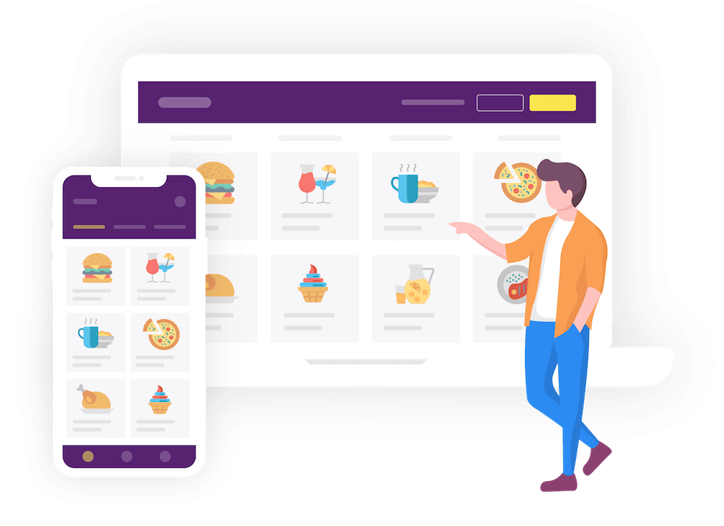

Introduction
Web application
People searching for new facilities.
Demand of feasibility increasing day
to day.
Creating a new dimension in this
modern world of technology
RJ Online Shop
Why we use
Huge selection and variety of products
Easy checkout process
Communication system
Invoice system
Security system

Slide 5


Objective
Information
Order
Learn
Web based automated system.
Cover all the information of product‘s.
Maintain the details of products .
Customer to order what they need.
Add to cart & checkout
Everyone can save the time.
Stay home safely.
To learn and implement a real-time application on database (DB).
Make easier to maintain the product details than the manual system.

Slide 6
Tool‘s and Technology
HOW MANY TECHNOLOGY HELPS ME
DO THE WORK
01
02
Frontend
Backend
Vue JS
JQuery
Bootstrap 4
PHP
03
04
Framework
Database
Laravel
MySQL

Slide 7


Feasibility
User Login
Customer
Admin
Economical
Free registration
View all products
Add to cart
Order
Message
Advance Security
Internet costs only, among other things.
Can manage all program

Slide 8


Module
Admin Module
Customer Module
Viewer Module

Slide 9
Initialization Interface
Viewer/Visitor
Server Error
Search Product
Customer Register
Clear All Filter
Login
About Authors
Customer
Admin
Contact Us

Slide 10
Customer
Search
Add to Cart
Products Information
Shipping Address
Message
Check Out
Order
Log Out

Slide 11
Admin
Dashboard
Product Type
Product Setup
Roles Setup
Stocks Setup
Brands Setup
Order Setup
Message Setup

Slide 12
Data Flow
For Registration
User Details
Register From
Email Exists
Database
Success
Login Form

Slide 13
For Login
User Request
Access Denied
Not Authenticate
Database
Authenticate
Buy Products

Slide 14
For Customer
User Request
Database
User Cart
Checkout

Slide 15
The Entity Relationship Diagram
roles
Relationship
Relationship
Relationship
Relationship
product_type
stocks
products
addresses
users
Relationship
brands
Relationship
Relationship
messages
orders
order_items
Relationship

Slide 16

User interface of our platform
Online ordering system has mainly three user interface.
These are
Admin
Viewer
Customer

Slide 17
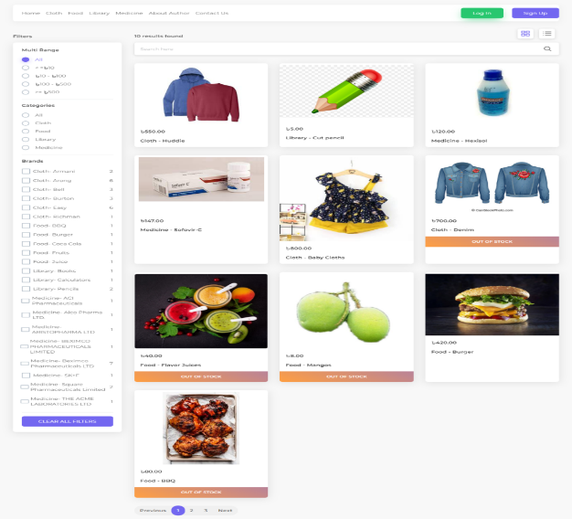
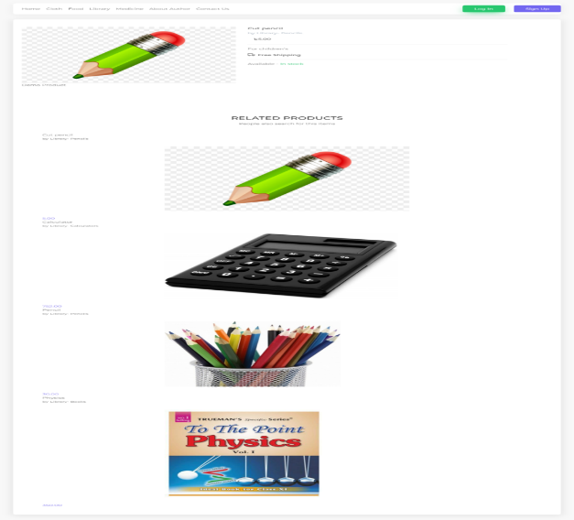
Visitor’s
Home Page
Product Information
Where viewers can see the product according to the category, brand and money range of their choice.
Viewers can also view the product information and other related products according to their categories

Slide 18
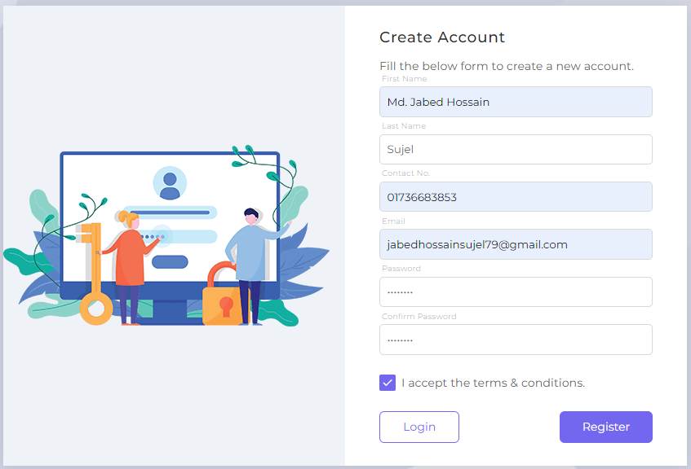
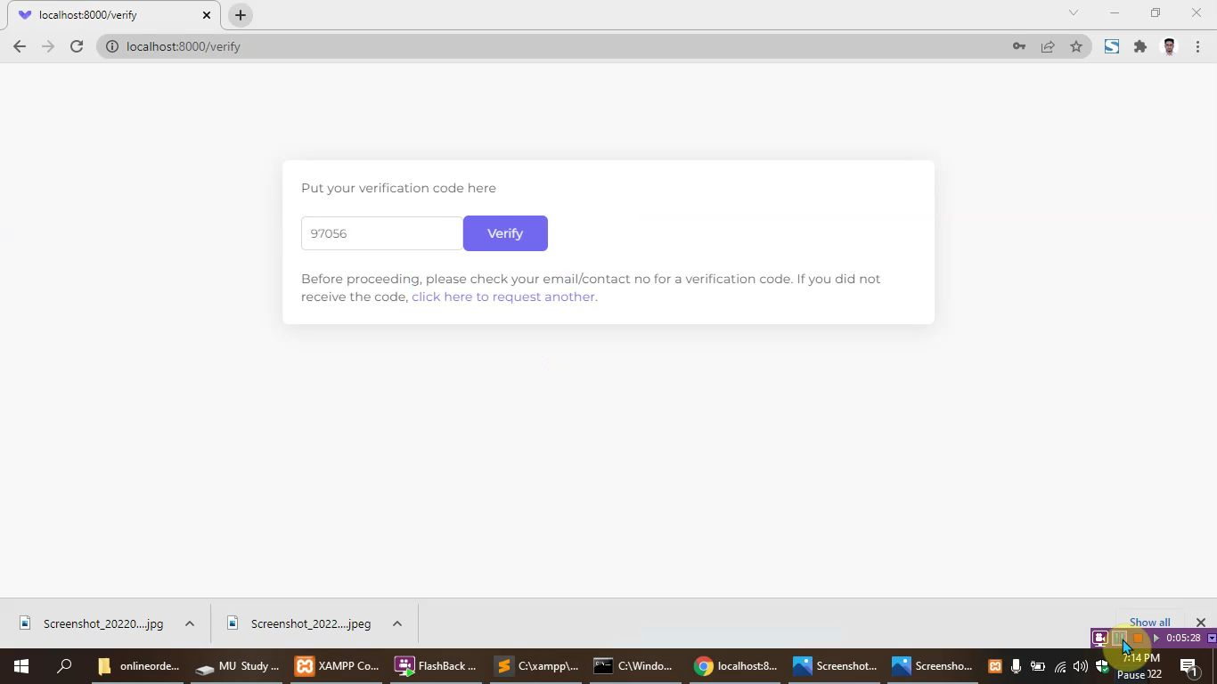
Customer
Customer Registration Form
OTP code
The Customer must fill out the registration form to order anything
In this case a customer must give him valid email and registered numbers before registering. Otherwise, you will not be able to register.

Slide 19
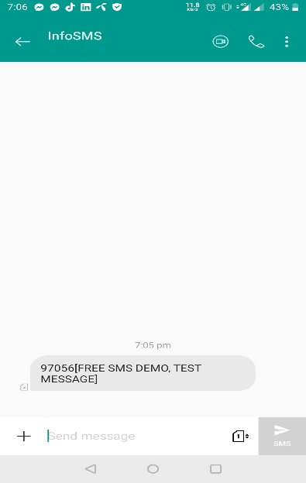
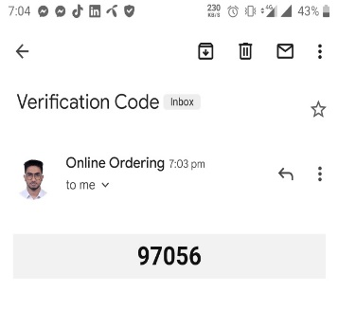
Verification Process
Email Verification Code
SMS Verification Code
When a customer registers with his/her valid email, an email verification code will be sent to his/her email from our website
When a customer registers with his/her number, an SMS verification code will be sent to his/her email from our Nexmo SMS Provider

Slide 20
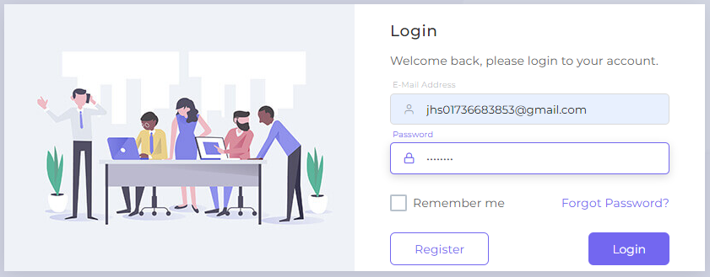
Customer Login
When the registration is completed, customer has to login with correct email and password

Slide 21
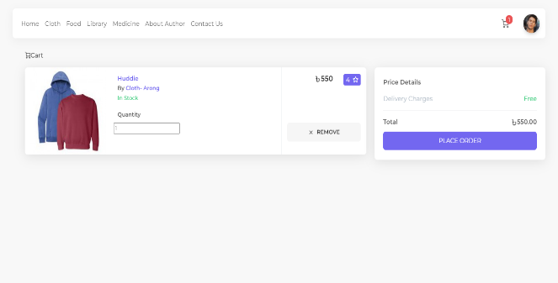
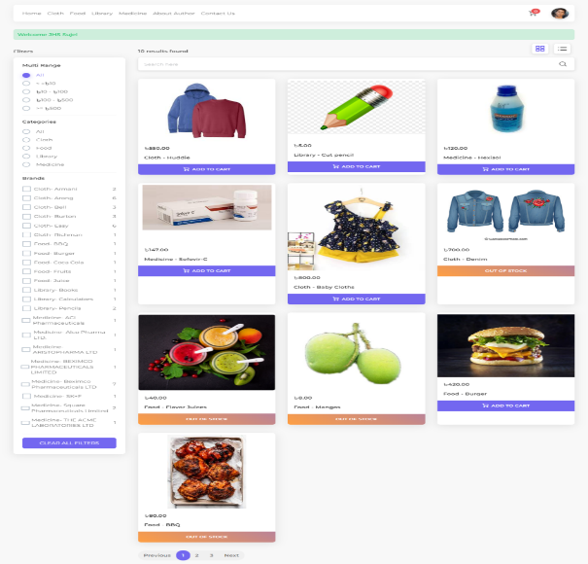
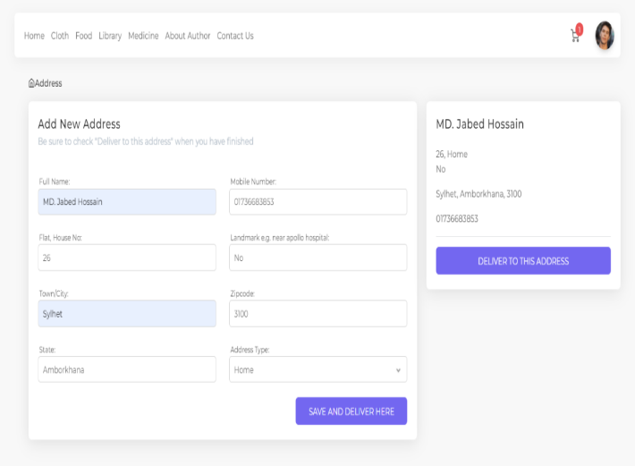
Customer Home Page
Add to Cart
This type of interface will appear in front of the customer after login. Where customer can find the info to his/her choice and also know if it is in stock.
Customer will be able to add the product of their choice by clicking the mouse.
Shipping Address form
In order to order the product, customer must send valid address. He need to checkout to make the order successful

Slide 22
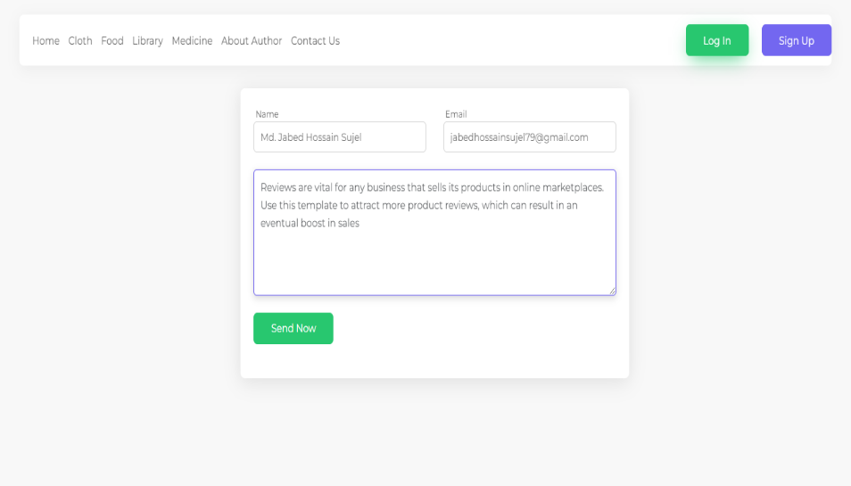
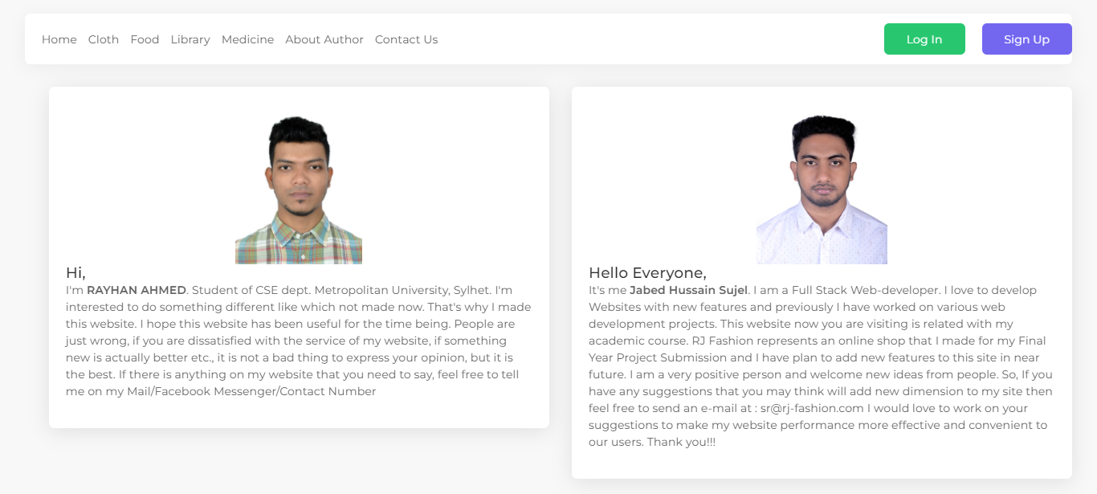
Message and Author details
Both visitor‘s and customers can send a message to the admin panel also can see the author about.

Slide 23
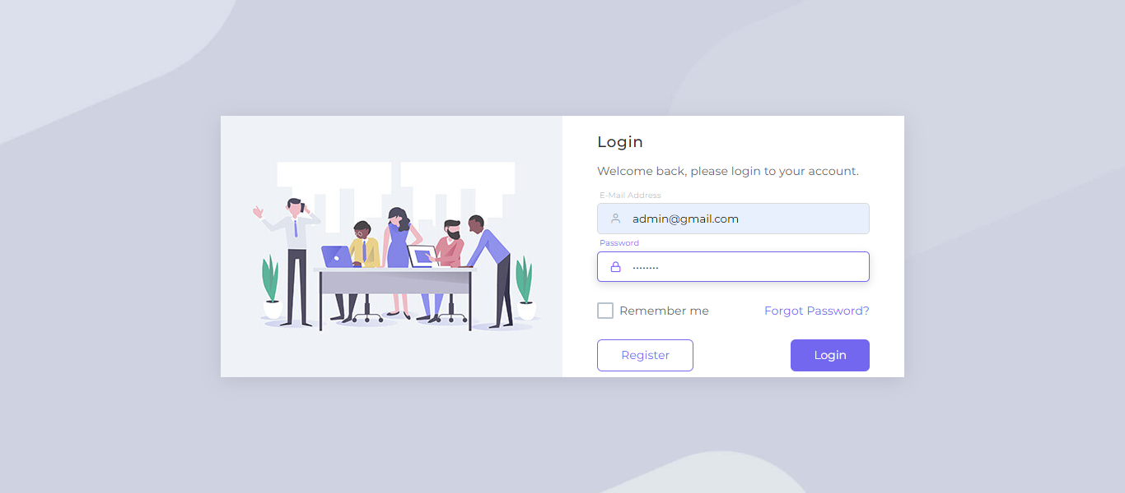
Admin
Admin Login
Admin has login with correct email and password

Slide 24
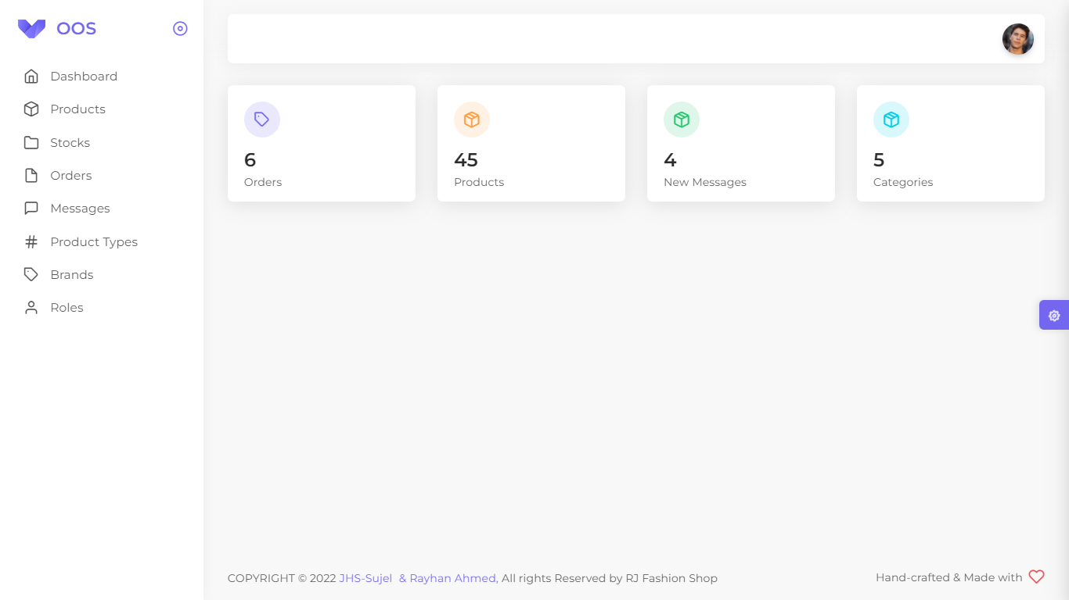
Dashboard
It will show the interface of how many orders, products, messages and categories there are.

Slide 25
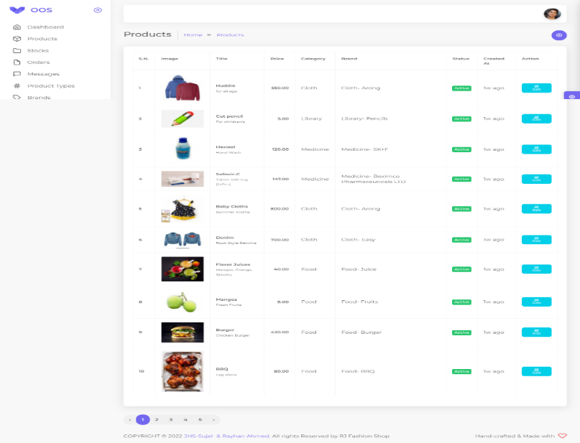
Products
This interface shows how many product there are and can be edited i.e. product activated and inactivated.

Slide 26
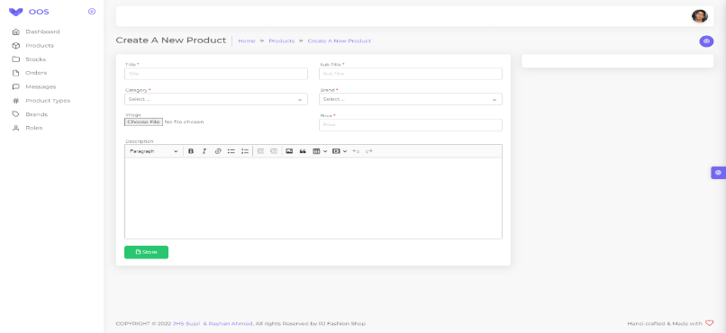
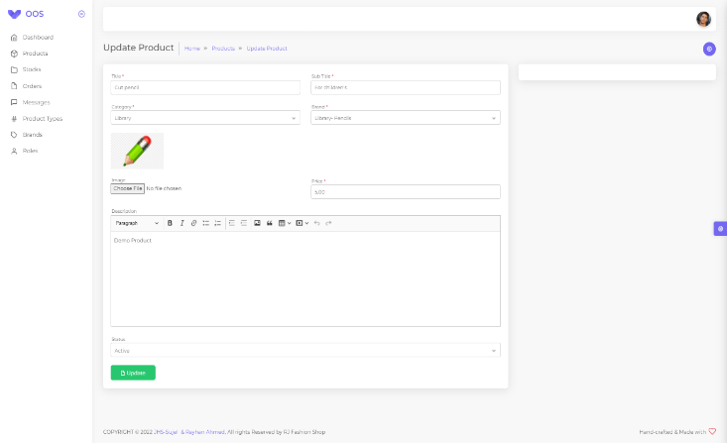
Product Create & Edit
With this interface, products can be added by their title, sub title, category, brand, image, price and description.
Admin can be edited product

Slide 27
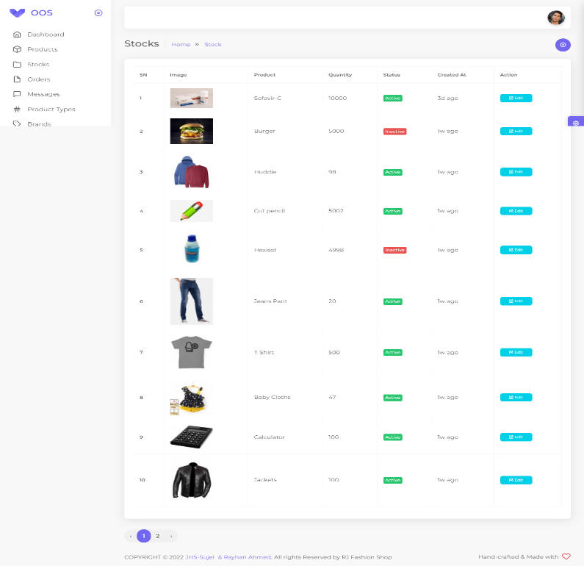
Stocks
When the products are added, the products have to be stocked to be displayed in the customer interface, otherwise the products will show “ out of stock “

Slide 28
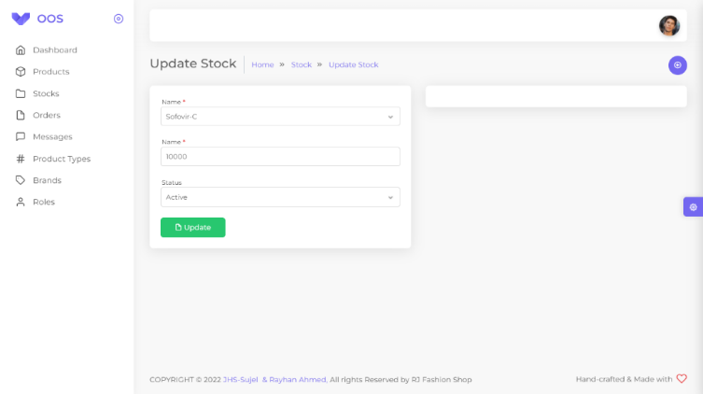
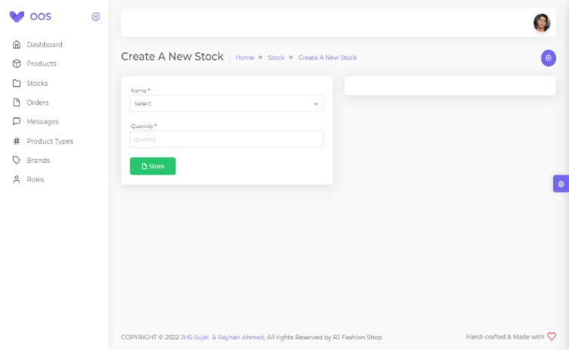
Stock Create & Edit
Admin will be able to activate and inactivate the product form stock. Which will show up as out of stock in the customer interface
The product are named according to the name under which they were saved and the products are stocked with their quantity

Slide 29
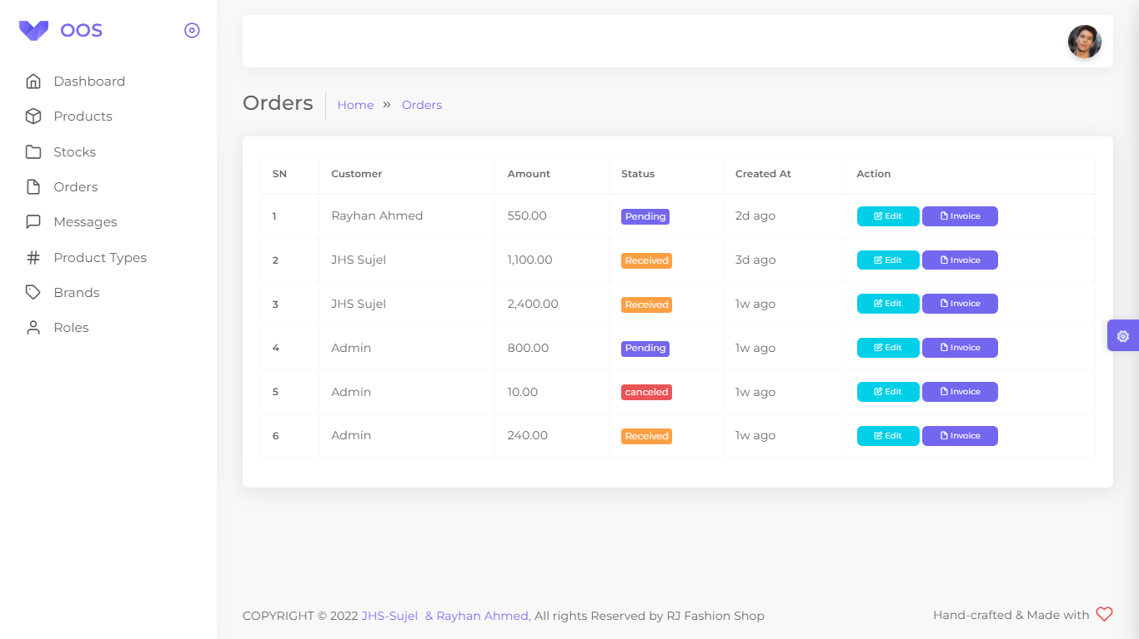
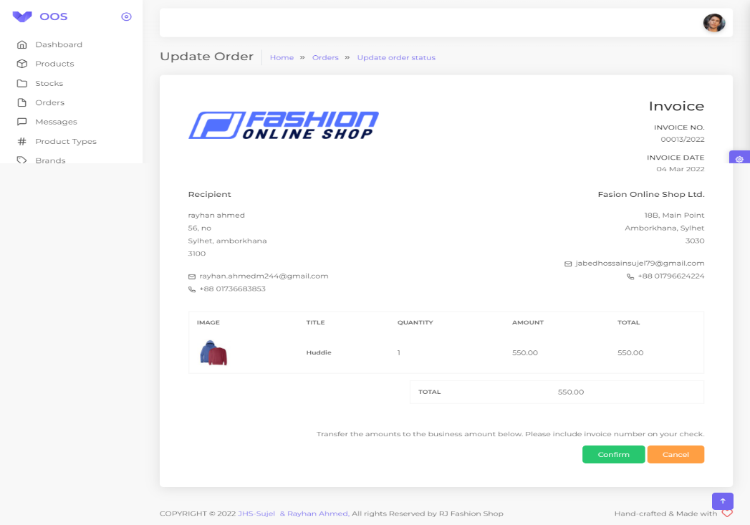
Order‘s
The admin will be able to see how many products the customer has ordered.
Admin will be able to cancle or confirm the order. Also invoice will be given as document

Slide 30
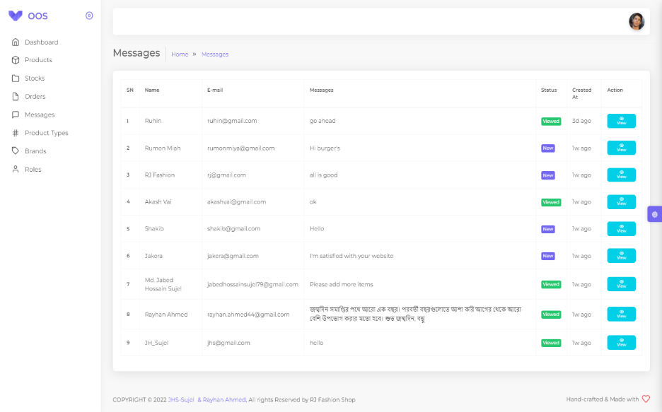
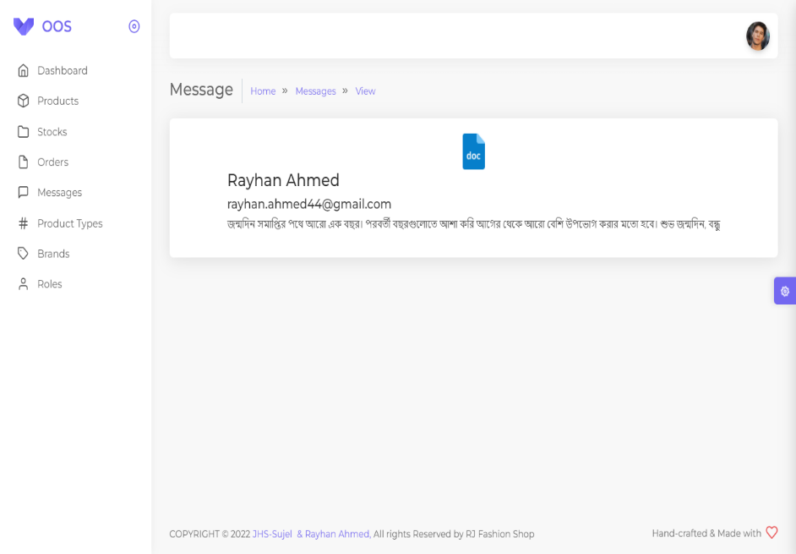
Message
From this interface the admin can see how many messages have come from viewers and customers.
Admin will be able to see messages from viewers and customers.

Slide 31
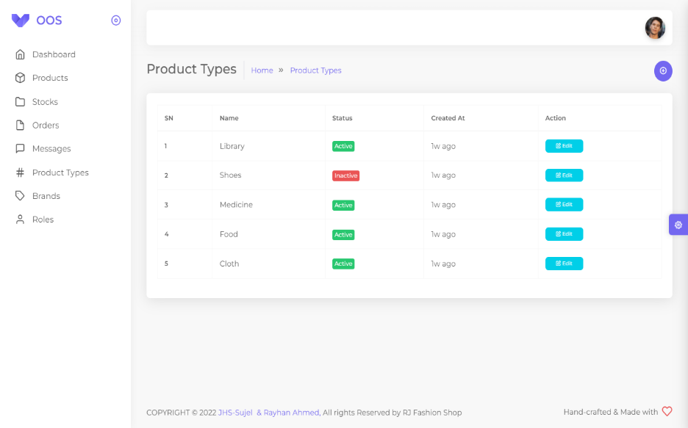
Product Types
The admin will be able to see how many products categories there are

Slide 32
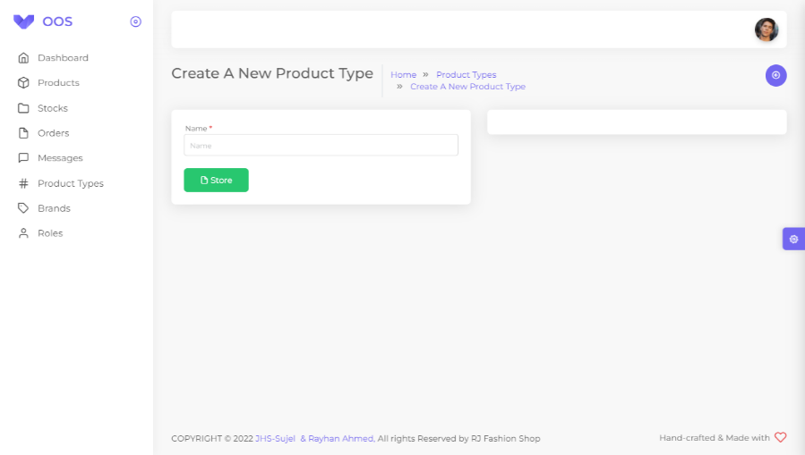
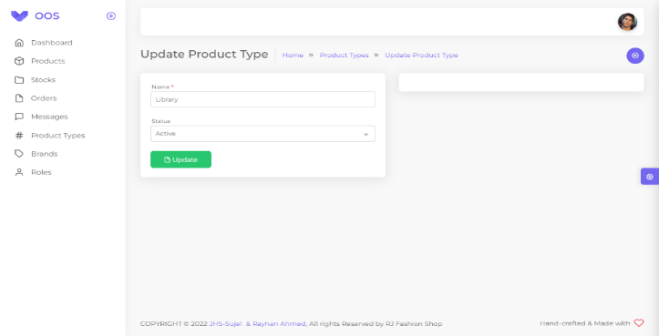
Products Create & Edit
Admin will be able to edit the product according to the category name and activate, inactivate them.
Admin will be able to add different categories according to the name of their categories

Slide 33
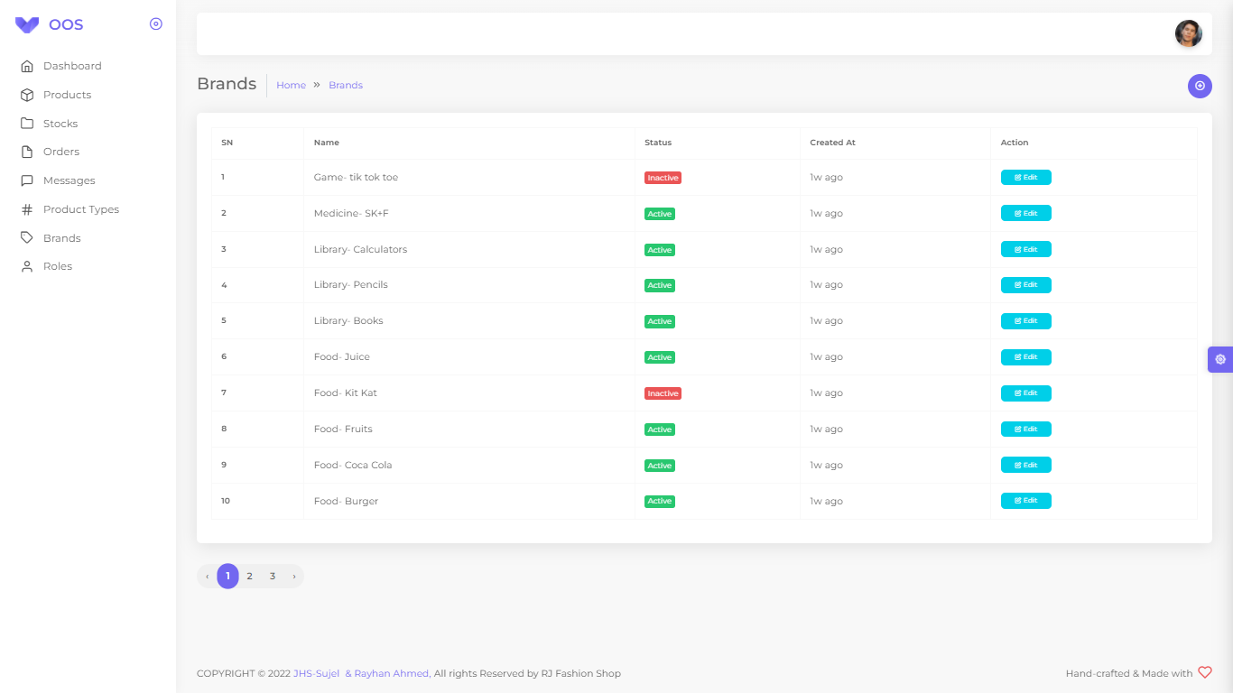
Brand‘s
The admin will be able to see how many products brands there are

Slide 34
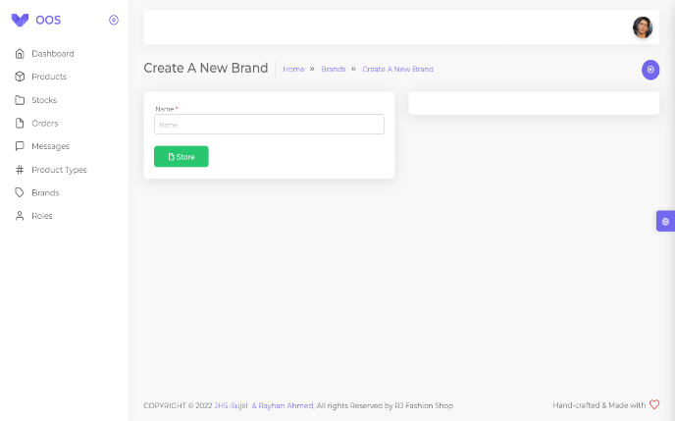
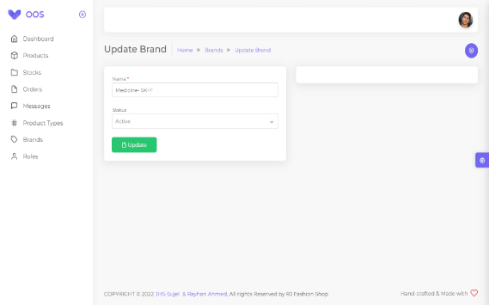
Brand‘s Create & Edit
Admin will be able to add different brands according to the name of their brands
Admin will be able to edit the product brands according to the brands name and activate, inactivate them.

Slide 35
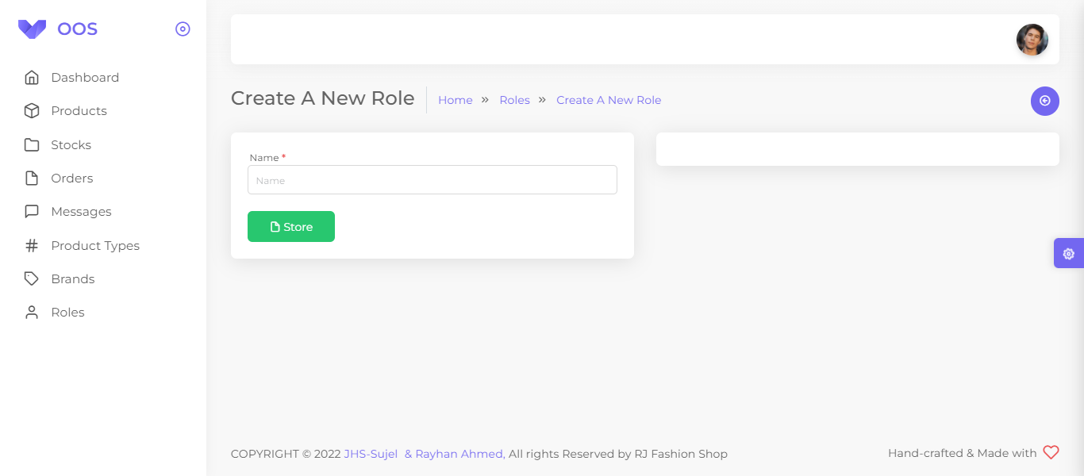
Roles
The admin will be able to see how many rules there are

Slide 36

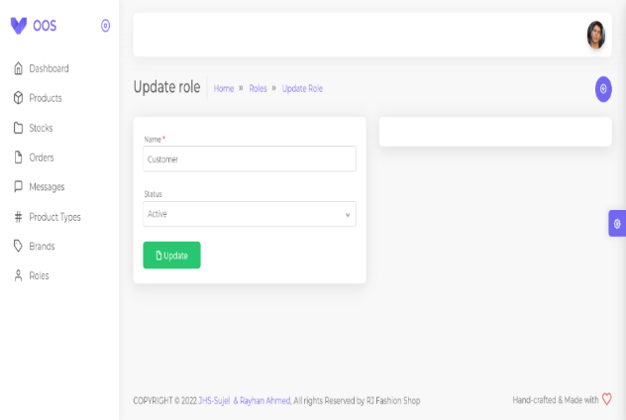
Roles Create & Edit
Admin will be able to add different rules according to the name of their rules
Admin will be able to edit the rules according to the rules name and activate, inactivate them.

Slide 37

Future Work
01
Want to Increase facilities of this project.
02
Want to add payment method like bKash, nagad etc.
03
Want to develop graphical design.
Want to add credit card option when I will starting my business by domain help.
04
05
Want to remove all the limitation.
06
Want to publish this website in online.

Slide 38
Thank You!

